Slide 1


Smart Plant Watering System
Date: 02/05/2025
Prepared By:
Enrollment Number: 220840131055,220840131054,220840131039,220840131030,220840131006
Name: Riddhi Mistry, Kishan Mistry, Siddeeka Khatri ,Mahek Bhathawala, Rushali ganvit

Slide 2
Outline
Abstract
Introduction
Existing Work
Methodology
Literature review(Publication Year, Introduction, Objective, technology, limitations)
Conclusion
Future scope

Slide 3
Abstract
This project demonstrates an automatic plant watering system using an Arduino UNO, soil moisture sensor, relay module, and water pump. The system automatically detects the moisture level in the soil and activates a water pump to irrigate the plant when moisture levels fall below a set threshold. This solution is ideal for home gardening, especially for users who are frequently away, ensuring that plants receive timely care without manual intervention.

Slide 4
Introduction
Watering plants is a crucial but often neglected task, especially for busy individuals. Inconsistent watering can harm plant health. This project aims to automate the process using affordable electronics, ensuring that plants are watered only when necessary, thereby conserving water and maintaining soil health. It makes use of Arduino microcontroller technology to monitor real-time soil moisture and actuate a motor-driven pump through a relay.

Slide 5
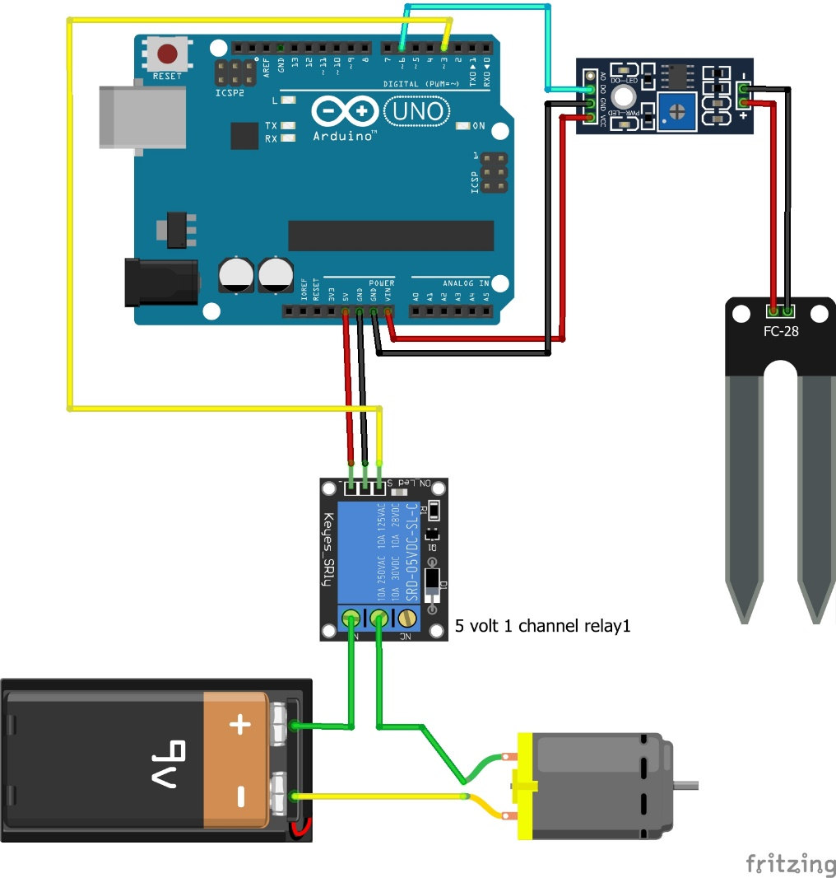
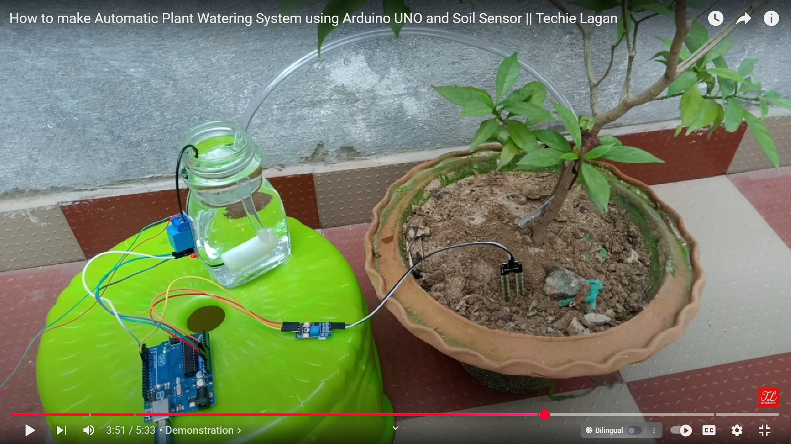
Existing Work

Slide 6
Methodology
Components Used:
Arduino UNO: Microcontroller to control the system.
Soil Moisture Sensor (FC-28): Measures the moisture level of soil.
Relay Module (5V): Acts as a switch to control the water pump.
Water Pump (DC Motor): Pumps water to the plant.
9V Battery: Powers the motor.
Jumper wires and breadboard: for connections.
Working Principle:
The soil moisture sensor is placed in the soil to continuously monitor moisture levels.
The sensor sends an analog signal to Arduino.
If the moisture level is below the threshold, the Arduino sends a HIGH signal to the relay module.
The relay triggers the DC water pump powered by a 9V battery.
Water is pumped into the plant until the soil reaches a predefined moisture level.
Once the desired moisture level is reached, the relay is turned off, stopping the water pump.

Slide 7
Literature review
Publication Year | Introduction | Objective | Technology Used | Limitations
2018 | A study on automated irrigation using soil sensors | To develop water-efficient irrigation | Arduino, Soil Sensor, GSM Module | Lacks real-time feedback, SMS delays
2019 | Design of smart garden systems using IoT | Create IoT-based remote watering | NodeMCU, Blynk App | Dependency on internet
2020 | Automated watering using microcontrollers | Efficient plant care automation | Arduino UNO, relay, soil sensor | Limited scalability, local-only operation
2021 | Smart agriculture systems | Large-scale agricultural automation | Raspberry Pi, sensors, ML | High cost, complexity
2022 | Low-cost irrigation with Arduino | Build low-cost smart irrigation | Arduino, motor, relay | Limited to small gardens, no weather prediction

Slide 8
Conclusion
This project provides a simple, effective, and low-cost solution for automatic plant watering. By integrating basic sensors with microcontroller logic, it ensures timely irrigation and helps conserve water. The system eliminates human error and provides peace of mind for plant owners. It is especially useful for small-scale home gardens.

Slide 9
Future scope
Wi-Fi/Bluetooth Integration: Connect the system to a smartphone app for remote monitoring and control.
Solar Power: Use solar panels to make the system energy-efficient and self-sustaining.
Weather Integration: Combine with weather APIs to avoid watering before rainfall.
Multiple Plant Zones: Extend to water multiple plants/zones with scheduling.
Nutrient Monitoring: Add sensors for pH and EC to monitor soil health comprehensively.

Slide 10
Thank You!

